Slide 1
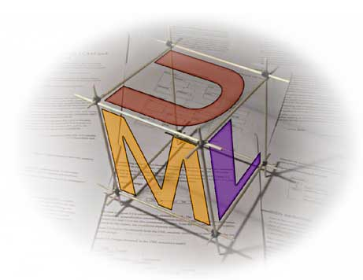
UML
Básico I
V1.0
11 Diciembre 2010
Ferreiras

Slide 2


Slide 3

Unified
Modeling
Language
UML
Es
Lenguaje Unificado de Modelado !!

Slide 4
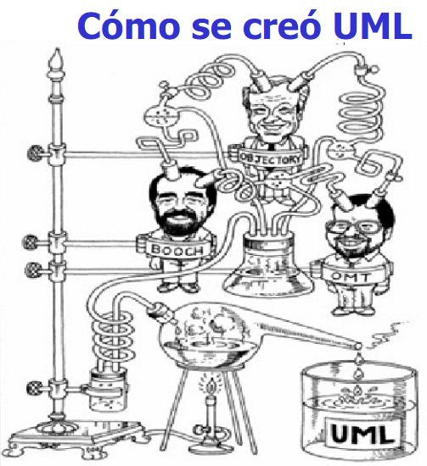
http://dis.um.es/~jnicolas/CSW/transparencias/Capitulo01p01.pdf

Slide 5
The Unified Modeling Language® (UML) was developed in conjunction with The Unified Process. Throughout the entire Unified Process lies the idea of creating models of the system being constructed. Models represent abstract views of the system from a particular point of view. These models are captured and communicated using UML.

Slide 6
UML is a powerful tool for some people and multiple books have been published on it including two by the process authors Booch, Rumbaugh and Jacobson:
The Unified Modeling Language® User Guide
The Unified Modeling Language® Reference Manual
These books may be used as the definitive references on UML. It is also recommended that you acquire the easier to read Martin Fowler book "UML Distilled."

Slide 7
VERSIONES DE UML
Al día de hoy (Dic. 2010), la Ultima versión liberada es:
Version: 2.3
Date: 05-2010
Description: Current version of UML - minor revision to the UML 2.2, clarified associations and association classes, added final classifier, updated component diagrams, composite structures, actions, etc.
See: http://www.uml-diagrams.org/

Slide 8
“
There was a lot of agreement that UML is too complicated and we need to find a way to simplify it for normal people.
“
Steve Cook,
Leader of the UML revision task force,
September 28, 2009
http://blogs.msdn.com/b/stevecook/archive/2009/09/28/reflections-on-the-omg-meeting-in-san-antonio.aspx

Slide 9
For the person’s who don’t know it, UML is something like a programming language. But instead of using much text, you try to make things with symbols and images. That gives great advantages because you can almost instantly see what the designer’s idea is about the application you are creating. And the programmer can instantly see what he needs to code. The only downside is that UML costs a lot of time. So for small applications it is not very usefull. But for bigger ones it certainly is.

Slide 10
“
One of the purposes of UML was to provide the development community with a stable and common design language that could be used to develop and build computer applications. UML brought forth a unified standard modeling notation that IT professionals had been wanting for years. Using UML, IT professionals could now read and disseminate system structure and design plans — just as construction workers have been doing for years with blueprints of buildings.”, Donald Bell, IT Architect, IBM Corporation.
“
http://www.ibm.com/developerworks/rational/library/769.html

Slide 11
 UML es un lenguaje de modelado visual de propósito general que, entre otros usos, es utilizado para visualizar, especificar, construir y documentar la arquitectura de un sistema de software;

Slide 12
 UML es utilizado para definir un sistema, para detallar los productos generados en la construcción de un sistema .. UML es el lenguaje en el que está descrito el modelo.

Slide 13

 UML no es un lenguaje de programación, pero hay herramientas CASE que se pueden utilizar para generar código en varios lenguajes de programación que reciben como entrada los diagramas UML. Actuando así como un generador de programa a partir de una representación grafica.

Slide 14
 UML tiene una relación directa con el enfoque de Análisis y Diseño Orientado a Objeto (ADOO), para modelar un sistema como un grupo de objetos que interactúan entre sí;

Slide 15
 UML es el estándar de modelado de sistemas mas usado. Desde el año 2005 UML es un estándar aprobado por la ISO como ISO/IEC 19501:2005 Information technology — Open Distributed Processing — Unified Modeling Language (UML). El Object Managemente Group Inc. (OMG) es su principal patrocinador, Ver en:
http://www.omg.org/index.htm
UML 2.3 Es la versión actual / dic2010
http://www.uml.org/

Slide 16
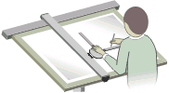
Model-Driven engineering
http://en.wikipedia.org/wiki/Model-driven_engineering
Model-driven engineering (MDE) is a software development methodology which focuses on creating models, or abstractions, more close to some particular domain concepts rather than computing (or algorithmic) concepts. It is meant to increase productivity by maximizing compatibility between systems, simplifying the process of design, and promoting communication between individuals and teams working on the system.

Slide 17
With the introduction of the Unified Modeling Language (UML), MDE has become very popular today
The best known MDE initiative is the Object Management Group (OMG) initiative Model-Driven Architecture (MDA), which is a registered trademark of OMG.

Slide 18
Model-Driven Architecture (MDA)
The model-driven architecture is a framework for software develoment,
defined by the Object Management Group (OMG), where development
efforts are driven by modeling (Kleppe, Warmer, and BAst 2003).
The models that you create following an MDA approach are formal; They
are highly detailed and developed using sophisticted modeling tools.
There are three models core to MDA:
- Plaform-independent model (PIM)... is similar in concep to logical
models from structured development.
- Platform-specific model (PSM) ... A model created by transforming
a PIM tailored to specify your system in terms of implementation
constructs available in one specific technology.
- Code: Is Generated by the transformation of PSMS
Source: “THE OBJECT PRIMER, THIRD EDITION, Agile Model-Driven
Development with UML 2.0, Scott W. Ambler, Cambridge University Press, 2004”

Slide 19
■ MDSD / MDD: We ( me too, -ff-) prefer the abbreviation MDSD for Model-Driven Software Development over the less-precise variant ‘MDD’ (Model Driven Development). The first abbreviation has become more popular in the software modeling community over the past two years
■ The Challenge: Software is today a relevant part of the machinery of all technology-based and many service-based businesses. H
■ Eventually, the weaknesses of mainstream IDEs and UML tools led to the formation of the OMG’s MDA initiative. Appropriate tools allow users to define precisely how UML models are to be mapped to combinations of company-specific implementation technology

Slide 20
The idea of modeling is not exactly new, and is used mostly for sophisticated development processes to document a software’s inner structure. Developers then try to counteract the inevitable consistency problems with time-consuming reviews. In practice, these reviews and also the models are among the first victims when time presses – from a pragmatic point of view, even rightly so. Another approach is ‘round-trip’ or reverse engineering, which most UML tools offer, which is merely source code visualization in UML syntax: that is, the abstraction level of these models is the same as for the source code itself . Visually it may be clearer, but the essential . problem remains the same.

Slide 21
Model-Driven Software Development offers a significantly more effective approach: Models are abstract and formal at the same time. Abstractness does not stand for vagueness here, but for compactness and a reduction to the essence. MDSD models have the exact meaning of program code in the sense that the bulk of the final implementation, not just class and method skeletons, can be generated from them. In this case, models are no longer only documentation, but parts of the software, constituting a decisive factor in increasing both the speed and quality of software development. We emphasize ‘model-driven’ as opposed to ‘model-based’ to verbally highlight this distinction.

Slide 22
Model-Driven Software Development (MDSD) is currently a highly regarded development paradigm among developers and researchers. With the advent of OMG's Model-Driven architecture (MDA) and Microsoft's Software Factories, the MDSD approach has moved to the centre of the programmer's attention, becoming the focus of conferences such as.

Slide 23
■ Executable models as a solution
Submitted by Anonymous on Fri, 07/30/2010 - 07:38.
Am I missing something or executable models are a new name for an old concept: code generation from models with precise semantic?
... Thus, we grant alignment of models and code, because you customize the rules and not the running apps. The approach has been successfully applied to mid-size to huge industrial cases.

Slide 24
■ Executable UML is more than code-generation from UML models
Submitted by jordi on Sat, 07/31/2010 - 02:38.
To me Executable UML is more than code-generation. Code-generation is a strategy to achieve Executable UML but not the only one, we could have a UML virtual machine able to directly interpret and run UML models (see for instance: The Architecture of a UML Virtual Machine )

Slide 25
■ Model maintenance
Submitted by Anonymous on Thu, 06/17/2010 - 23:24.
The problem with modeling is maintenance of the model artifacts ( A work product or deliverable in the system development process), which have to be updated as the model changes. Currently modeling is more used to understand the project in the initial stages of the project. Also making sure the model is the one being implemented is another painful issue. What we need is executable models. Also executable models help you in changing the model much faster than traditional development (converting the model to code manually).

Slide 26
■ Modeling will be key to Engineering and Science
Submitted by Anonymous on Wed, 06/16/2010 - 08:56.
Modeling is a way of reasoning and organizing domain knowledge. Employers might not understand its use yet, but as the plethora of information increases and the need to make sense of all that exist becomes so more important, modeling will start to permeate all areas of problem solving - not just software development.
http://modeling-languages.com/blog/content/uml-still-dominating-mde-job-market
UML still dominating the MDE job market.doc
Plétora: Abundancia excesiva de alguna cosa.

Slide 27
Generate Application Code from UML Models
UModel® 2011 includes a built-in code generator that creates Java, C#, or Visual Basic .NET code based on the classes in your UML model, freeing you from the mundane task of writing low level infrastructure code so you can concentrate on the business logic and overall architecture of your project.
Take advantage of the source code generated by UModel® 2011 to accelerate the implementation (coding) phase of your project and eliminate the unintended errors that can creep into manually written code and prove time-consuming to debug later on.
From:
http://www.altova.com/umodel/uml-code-generation.html

Slide 28
MODELOS Y MODELADO
Un modelo proporciona una visión abstracta de un sistema, destacando algunos aspectos importantes de su diseño, tales como las subrutinas y sus relaciones, y haciendo caso omiso de una gran cantidad de detalles de bajo nivel, tales como la codificación de cada rutina.
Modeling is a way of reasoning and organizing domain knowledge

Slide 29
 Los Modelos: Son las descripciones intermedias o documentos que se producen en el curso del desarrollo de una pieza de software; Son usados en el desarrollo de software para ayudar a entender el área de aplicación hacia la cual esta dirigido el sistema, ANTES de la etapa de codificación.

Slide 30
Por ejemplo, en el siguiente proceso estructurado de desarrollo de un software:
ELICITACION DE
REQUERIMIENTOS
MODULO DE
ESTRUCTURA
CODIGO
SC
SRS
SCH
Código fuente
Especificación de requerimientos
Grafica de la estructura del modulo

Slide 31
 En el ejemplo anterior, la gráfica de la estructura del módulo podría tener esta forma:
Esa gráfica es un modelo !!
PagarMatricula
ReciboDePago
CargarPago
Este modelo representa el flujo de los datos entre los módulos PagarMatricula, ReciboDePago y CargarPago. El modulo PagarMatricula verifica si ya hay un pago hecho consultando al modulo ReciboDePago; Si no hay un recibo de pago entonces el modulo PagarMaatricula ejecutara el modulo CargarPago.

Slide 32
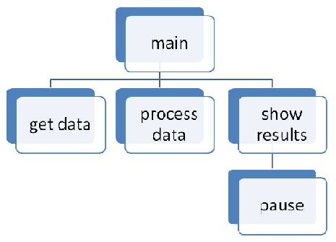
Do you remember
the modularization
in INF-510 ?
That's a model !!
 This model shows the relationship between modules (or functions). Detail logic of the program is not presented. It does represent the organization of the functions used within the program showing which functions are calling on a subordinate function. Those above are calling those on the next level down. They are created by the programmer to help document a program. They convey the big picture of the modules (or functions) used in a program.

Slide 33
Otro ejemplo, De INF-526:
Modelo Conceptual De Datos ER.
ENFERMERA
SALARIO
PABELLÓN
MEDICO
MEDICAMENTO
CAMA
PACIENTE
TRATAMIENTO

Slide 34
 Luego, los modelos son mucho más fáciles de entender que el código completo del sistema y son utilizados para ilustrar los aspectos de su estructura general o de su arquitectura.

Slide 35



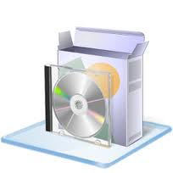
EN RESUMEN
Haberlo dicho antes !!
El problema
El dominio del problema
El producto
El modelo UML
La transformación hacia una plataforma específica.

Slide 36
REFERENCIAS
- UML Distilled Third Edition, A Brief Gruide to the Standard Object Modeling Language, Martin Fowler, Addison-Wesley, 2004
- Practical Object-Oriented Design With UML, Second Edition, Mark Priestley, MacGraw-Hill, 2003
- Object-Orinted Systems Analysis And Design With UML, Robert V. Stumpf and Lavette C. Teague, Pearson Prentice Hall, 2005
- System Analysis & Design, An Object-Oriented Approach With UML, Alan Dennis, Barbara Haley Wixom, David Tegarden, John Wiley & Sons, Inc, 2002
- System Analysis & Design, Fourth Edition, Alan Dennis, Barbara Haley Wixom, Roberta M. Roth, John Wiley & Sons, Inc., 2009
- Analyse und Design mit UML 2.3: Objektorientierte Softwareentwicklung, Bernd Oestereich, Oldenbourg Wissensch.Vlg, Sep 2009
- Java(R) 7 The Complete Reference, 8th Edition, Herbert Schildt,
McGraw-Hill Osborne Media, 8th edition, 2011
- http://www.uml.org/

Slide 37
- THE OBJECT PRIMER, THIRD EDITION, Agile Model-Driven
Development with UML 2.0, Scott W. Ambler, Cambridge University Press, 2004

Slide 38

GRACIAS

